Slide 1
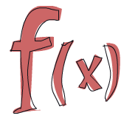
Towards a more functional C#

Slide 2
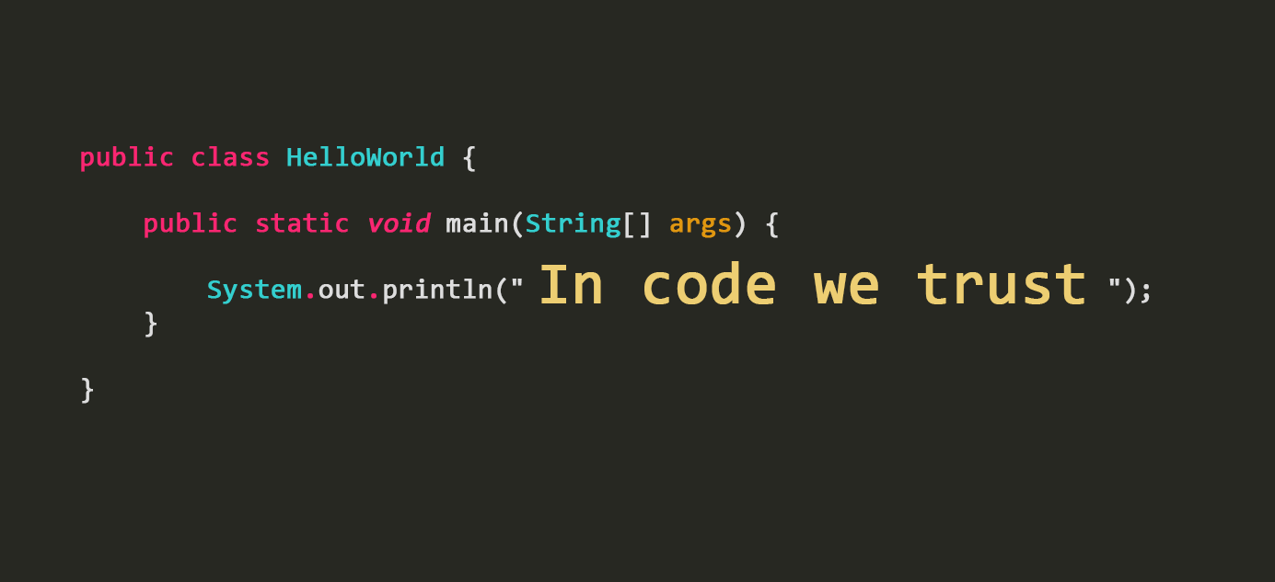
Coding Time

Slide 3

Thank you!

